Slide 1

Data interpretation
Instructions
1. Read the title carefully
2. Understand the units on either axis 1 mn = ${10}^{6}$, 1 bn = ${10}^{9}$
3. Understand the keys or the legends
4. Take care of special characters ? ! *
5. Here convert the bar chart or line graph into a frequency table.
6. Take care of TRAP questions

Slide 2
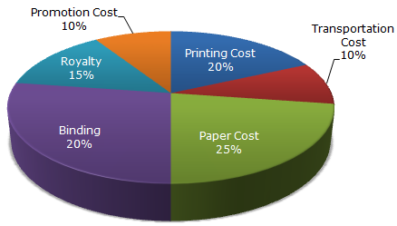
Pie Charts
The following pie – chart shows the percentage distribution of the expenditure incurred in publishing a book. Study the pie – chart and the answer the questions based on it.
Various Expenditures (in%) Incurred in publishing a Book

Slide 3
Exercise
. If for a certain quantity of books, the publisher has to pay ₹. 30,600 as printing cost, then what will be the amount of royalty to be paid for these books?
a) ₹ 19, 450
b) ₹ 21, 200
c) ₹ 22, 950
d) ₹ 26, 150
Printing cost = 20%
Royalty = 15% The amount of royalty to be paid = 15/20 x 30600 = 22950

Slide 4
Exercise
What is the central angle of the sector corresponding to the expenditure incurred on Royalty?
a) 15
b) 24
c) 54
d) 48
100% = 360 degrees
1% = 3.6 deg
Therefore angle of the sector (royalty) = 15 x 3.6 = 54 degrees

Slide 5
Exercise
The price of the book is marked 20% above the C.P. If the marked price of the book is ₹ 180, then what is the cost of the paper used in a single copy of the book?
a) ₹ 36
b) ₹ 37.50
c) ₹ 42
d)₹ 44.25

Slide 6
Exercise
. If 5500 copies are published and the transportation cost on them amounts to ₹. 82,500, then what should be the selling price of the book so that the publisher can earn a profit of 25%?
a) ₹ 187.50
b) ₹ 191.50
c) ₹ 175
d) ₹ 180

Slide 7
solution

Slide 8

Exercise
Royalty on the book is less than the printing cost by what %:
a) 5%
b) 33$\frac{1}{3}\%$
c) 20%
d) 25%
Printing cost = 20%
Royalty cost = 15%
Royalty cost is less by 5%
The % by which cost of royalty less than printing by
= $\frac{5 x 100}{20}$ = 25%

Slide 9
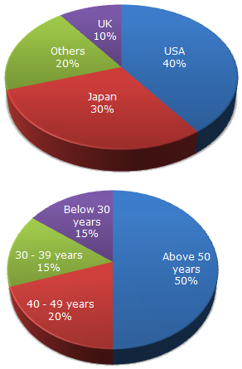
Exercise
The following pie charts exhibits the distribution of the overseas tourist from India. The two charts show the tourist distribution by country and the age profiles of the tourist respectively.
Distribution of Overseas Tourist Traffic from India

Slide 10

Exercise
. What percentage of Indian tourists went to either USA or UK?
a) 40%
b) 50%
c) 60%
d) 70%

Slide 11
Exercise
. The ratio of the number of Indian tourists that went to USA to the number of Indian tourists who were below 30 years of age is?
a) 2: 1
b) 8 : 3
c) 3 : 8
d) Cannot be determined

Slide 12
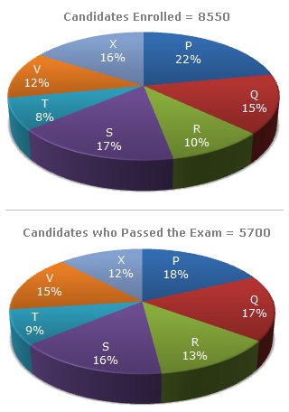
Exercise
Distribution of candidates who were enrolled for MBA entrance exam and the candidates (out of those enrolled ) who passed the exam in different institutes:

Slide 13
Exercise
. What percentage of candidates passed the Exam from institute T out of the total number of candidates enrolled from the same institutes?
a) 50%
b) 62.5%
c) 75%
d) 80%

Slide 14
Exercise
which institute has the highest percentage of candidates passed to the candidates enrolled?
A) Q
B) R
C) V
D) T

Slide 16
Exercise
. The number of candidates passed from institutes S and P together exceeds the number of candidates enrolled from institutes T and R together by :
a) 228
b) 279
c) 399
d) 407

Slide 17
Exercise
. What is the percentage of candidates passed to the candidates enrolled for institutes Q and R together?
a) 68%
b) 80%
c) 74%
d) 65%

Slide 18
Exercise
What is the ratio of candidates passed to the candidates enrolled from institutes P?
a) 9 : 11
b) 14 : 17
c) 6 : 11
d) 9 : 17

Slide 19
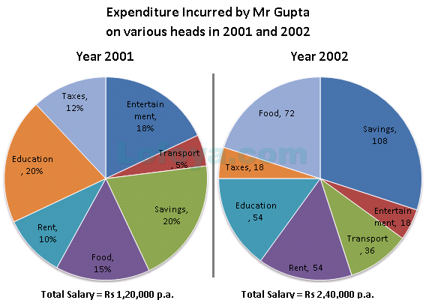
Exercise
.
These questions are based on the pie charts given below

Slide 20
Exercise
How much more money does Mr Gupta spend on taxes than on transport in the year 2001?
 | A. | Rs.8,400
 | B. | Rs 12,000
 | C. | Rs 14,400
 | D. | Rs 15,600
 | E. | CBD

Slide 21
Exercise
How much more money was spent on education than on entertainment in the year 2002?
 | A. | Rs. 6,000
 | B. | Rs 14,000
 | C. | Rs 18,000
 | D. | Rs 22,000
 | E. | None of these

Slide 22
Exercise
The percentage increase in the savings from2001 to 2002 is how many percentage points less than that of transport?
 | A. | 66.66%
 | B. | 100.00
 | C. | 133.33
 | D. | 150.25
 | E. | 200.75

Slide 24
Exercise
What is the percentage increase in the angle subtended at the centre by food In 2002 over that in 2001?

Slide 25
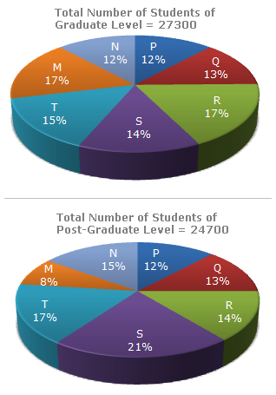
Exercise
Distribution of Students at Graduate and Post Graduation levels in Seven Institutes:

Slide 26
Exercise
. What is the total number of graduate and post – graduate level students in institute R?
a) 8320
b) 7916
c) 9116
d) 8099

Slide 27
Exercise
What is the ratio between the number of students studying at graduate and post – graduate levels respectively from institute S?
a) 14 : 19
b) 19 ; 21
c) 17 : 21
d) 19 : 14

Slide 28
Exercise
How many students of institutions of M and S are studying at graduate level?
a) 7516
b) 8463
c) 9127
d) 9404

Slide 29
Exercise
What is the ratio between the number of students studying at Post – graduate level from institutes S and the number of students studying at graduate level from institute Q?
a) 13 : 19
b) 21 : 13
c) 13 : 8
d) 19 : 13

Slide 30
Exercise
Total number of students studying at post graduate level from institutes N and P is
a) 5601
b) 5944
c) 6669
d) 8372

Slide 31
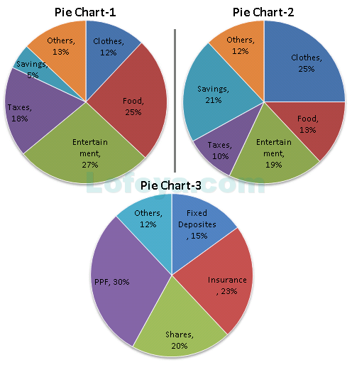
Exercise
Pie chart I and Pie chart II show the break up – according to different expenditure heads and savings of the incomes of Mr. and Mrs. Anand respectively. Pie chart III shows the break up – according to the type of savings – of the total savings of the couple ( i.e., the savings of Mr. and Mrs. Anand put together).

Slide 32
Exercise
If Mr. Anand’s savings are twice the total savings of the couple invested in fixed deposits , what is the ratio of the income of MR. Anand to that of Mrs. Anand?
a) 7 :3
b) 3 : 7
c) 5 : 9
d) 9 : 5

Slide 33
solution
Savings in F D = 15%
Mr. Anand’s savings = 2 x 15 = 30%
Therefore Mrs. Anand’s savings = 100 – 30 = 70%
Ratio of savings : mr.A : mrs. A = 3 :7
From the pie chart Mr.A is saving 5% of his income and Mrs. Is
Saving 21% of her income
∴ 5% of mr.A’s income : 21% of mrs.A’s income = 3:7
--→ 35% of mr.A’s income = 63% of mrs.A’s income
So, Mr.A’s income : mrs.A’s income = 63 : 35 = 9 : 5

Slide 34
Exercise
If the ratio of the income of Mr. Anand to that of Mrs. Anand is 3 :1, the total savings of the couple invested in PPF as a % of Mr. Anand’s savings are:
a) 50%
b) 65%
c) 72%
d) 78%

Slide 35

solution
Ratio of income mr.A : mrs.A = 3:1 = 1:1/3
Ratio of savings = 5 : 21/3 = 5 : 7 total = 12
Savings in PPF = 30% ==➔ 30% of 12 = 3.6
So, $\frac{PPF x 100}{Mr.A^{′}s savings}$ = $\frac{3.6 x 100}{5}$ = 72%

Slide 36
Exercise
If for an income of up to ₹ 1 lakh, no tax is charged and for any income above ₹ 1 lakh. The rate of tax for males and females is 30% and 20% respectively of the income in excess of ₹ 1 lakh, then what is the ratio of the income of Mr. Anand to that of Mrs. Anand?
a) 3 : 4
b) 5 : 4
c) 4 : 5
d) None of these

Slide 37
solution
Mr.A’s income
30 % of (Mr.A’s income – 1 lakhs) = 18% of Mr.A’s income
30% of Mr. A’s income – 30,000 = 18% of Mr. A’s income
--→ 12% of Mr. A’s income = 30,000
Mr.A’s income = ₹.2, 50,000
Mrs.A’s income
20% of (Mrs.A’s income– 1 lakhs ) = 10% of Mrs. A’s income
20% of Mrs. A’s income – 20,000 = 10% of Mrs. A’s income
-→ 10% of Mrs. A’s income = ₹. 20,000
Mrs.A’s income = ₹. 2,00,000 The ratio = 25:20 = 5: 4

Slide 38
Exercise
If the expenditure on clothes by Mr. Anand and that by Mrs. Anand are in the ratio 2 : 5, then what is the ratio of the income of Mrs. Anand to that of Mr. Anand?
a) 5 : 6
b) 4 : 5
c) 5 : 4
d) None of these

Slide 39
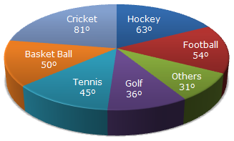
Example
The circle-graph given here shows the spendings of a country on various sports during a particular year. Study the graph carefully and answer the questions given below it.

Slide 40
example
What percent of total spending is spent on Tennis?

Slide 41
example
How much percent more is spent on Hockey than that on Golf?

Slide 42
example
If the total amount spent on sports during the year be Rs. 1,80,00,000 , the amount spent on Basketball exceeds on Tennis by:

Slide 43
example
How much percent less is spent on Football than that on Cricket?

Slide 44
example
If the total amount spent on sports during the year was Rs. 2 crores, the amount spent on Cricket and Hockey together was:

